Slide 1
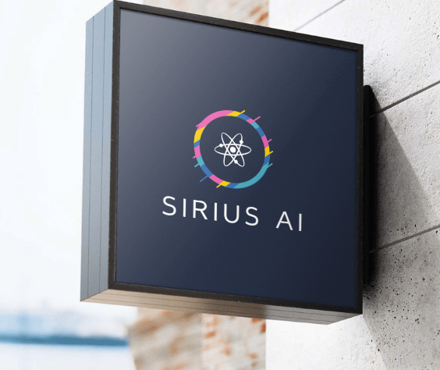
SIRIUS AI (AI + Simplicity) for Enterprises

Slide 2
Agenda
History, Hype and Future
Pivot: Generative AI Vs Traditional AI
Rapid changing landscape & transformative opportunity
Tenets of Generative AI solution for FSS
Orchestration of technology
AI Delivery approach: Simplicity in execution
Sirius AI experience

Slide 3
History, Hype and Future
Cover background of Generative AI: Foundation model in 2017,….
Scale of growth: 100mn in 2 months, no of gen AI models, timeline of releases, size of models & growth etc
How use cases are evolving and from panacea to industry specific use cases have come to the fore
SOURCE: research on Gartner, IDC, Forbes, WSJ, Accenture, IBM, McKinsey, Deloitte, BCG, Microsoft, Google, etc

Slide 4
Generative AI vs Traditional AI
What are the use cases covered in traditional vs Generative
Traditional: Predictive, forecasting, Classification
Generative: Summarization, Semantic Search, Content Creation, RAG, Code creation
Generative AI to supplement Traditional AI
Growth from Advanced analytics-> ML->DL->Gen AI with examples

Slide 5
Rapid Changing Landscape & Transformative Opportunity
Pace & Scale of Change both are huge
Continuous changes in players, capabilities-> Keeping up to date is critical
Technical challenges are being created and solved: Bias/Hallucination
Long term cost of operations vs transformation
What we can do?
Focus on Business and use that to drive prioritization in Gen AI
Pick a stack and do quick low intensity + High impact pilots to prove value->
define a business case from there

Slide 6
Tenets of the Generative AI solution
Slide for our differentiation
Platform Agnostic
Domain specific Generative AI: Talk about 4 approaches of building Gen AI- prompting, fine tuning, RAG, finetuning+prompting
Continuous selective enhancement
Consumption focused-> Simplified. Input from end users to shape the solution
Industry specific application and use cases for Gen AI
Optionalities of technology to choose from – open source, proprietary
Value of External data

Slide 7
Tenets of the Generative AI solution
Slide for our differentiation
Platform Agnostic
Domain specific Generative AI: Talk about 4 approaches of building Gen AI- prompting, fine tuning, RAG, finetuning+prompting( 1 additional slide)
Continuous selective enhancement
Consumption focused-> Simplified. Input from end users to shape the solution
Optionality of technology to choose from – open source, proprietary(common arch slide additional)
Value of External data(1 additional slide)

Slide 8
Orchestration of technology
Common arch slide with components

Slide 9
AI delivery Approach
Integrated with your platform
Built on your Cloud platform
Simplicity of execution- interfaces which are simplified
OOB data solutions with third party data available

Slide 10
Sirius AI Experience
Talk about projects we have done with NLP, Third party data, FSS, DL/ML
Total experience, total projects, etc…

Slide 11
Appendix

Slide 12
Reference old slides

Slide 13










Generative AI can help transform 4 key functions within Standard Chartered
Generative AI Engine
1
Intelligent conversation interface to frontline staff to service customers
Product/Customer Strategy built on understanding ‘All Customer Interactions’: Chats, calls, emails, visits & external data
Truly Individualized Campaign creatives based on each Customer’s behavior and external data
Customer Service & experience Management
Generative AI & analytics platform
2
3
Document processing and simple summarization for operations: Call center transcripts, Underwriting summaries as an aid for underwriters
Smart Search for content across text, pdfs, images
4
Mid to Back office Transformation
Common data products & foundation layer
5
Simplify regulatory reporting and discovery of data reconciliation
Automate discovery and reporting summarization for Executive consumption
Simplify Reporting & data operations
6
7
Unstructured data: text, audio, visual
Talent mapping & hiring right: Resume summarization and customized skill mapping to hiring process.
Interview & assessment aid: transcript summary & review
Structured data: databases, reports
8
Talent management &
skill mapping
External data: digital footprint, B2B data, competitive data, public data/corpus
9
IT & data processing Accelerators
Code Co-pilots and test cases automation
10

Slide 14
How to prioritize by understanding boundaries of Generative AI
Domain | Use cases
Customer Service & experience Management | Intelligent conversation for Front office staff
 | Cross Channel Customer Insights
 | Hyper personalized campaigns
Mid to Back-office Transformation | Document processing & Summarization
 | Smart Search
Simplify Reporting and data operations | Regulatory reporting & Data reconciliation
 | Automate discovery & reporting summarization
Talent management and skill mapping | Talent Mapping & Hiring insights
 | Interview & Assessment aid
IT & data processing Accelerators | Co-pilot for coding & automation
Low accuracy needed & low risk
1
10
2
2
3
8
1
4
AI Accuracy needed by the problem
3
5
7
6
5
7
9
4
8
9
High accuracy needed & high risk
6
10
Better than previous generation
Transformative
Value Generation potential over traditional techniques

Slide 15
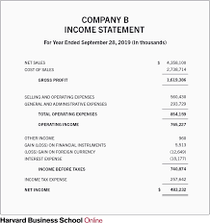


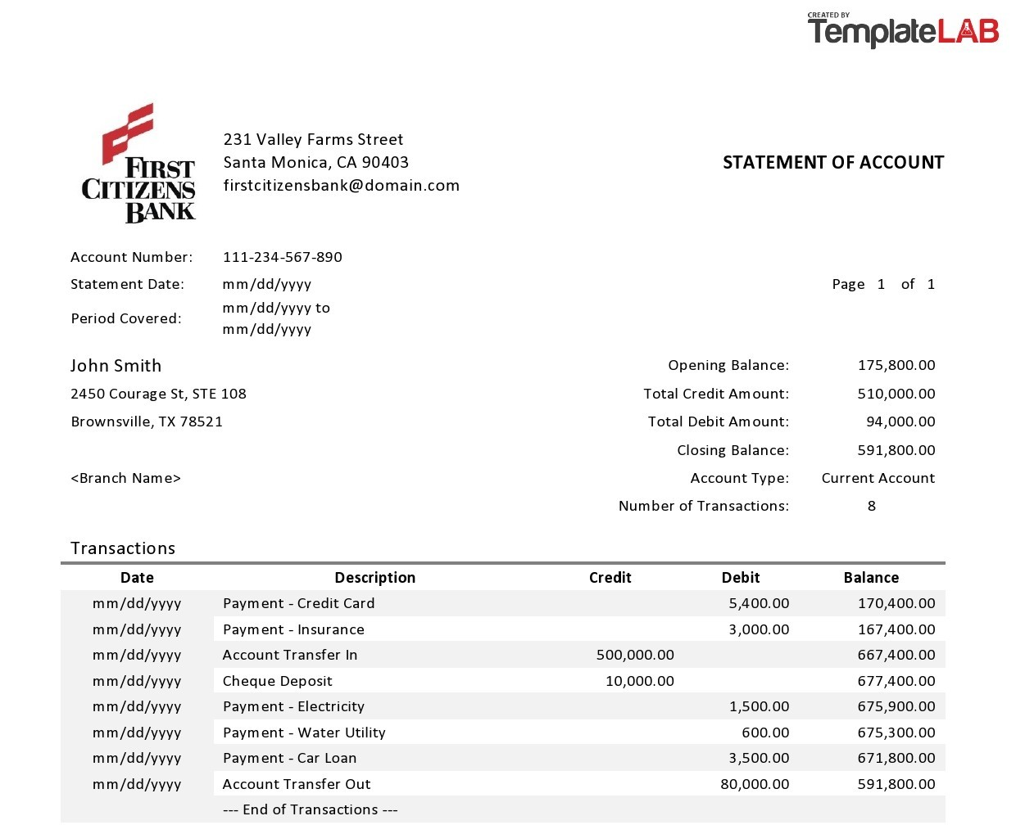




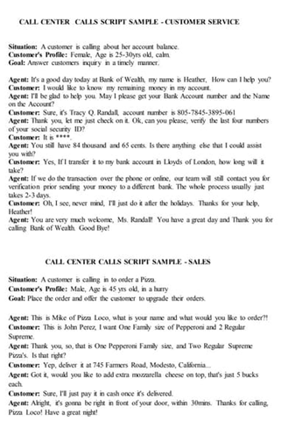

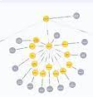
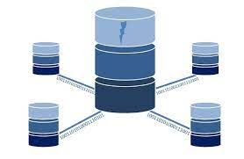

B2B Underwriter Assistant: Generative AI & Semantic Search
Unstructured documents from Customers
Underwriters
Underwriter AI Assistant
Chat
&
Query
Underwriter can query individual documents for information rather than searching manually
See summarize Interactions, Credit assessment reports and seek new information
Get simple structured response from multiple documents
Query internal databases for simple summary responses
Semantic Document Search Module
Customer Interactions: Chats/Calls
Customer Interactions: Chats/Calls
Information Summarization
Structured Data Graphs & Query
Structured Databases
Large Language Models

Slide 16


Semantic Search: Underwriter can find information rapidly from multiple documents
What is the profit for FY22 in the income statement?
Profit of Rs. 5,68,10,000 is mentioned in Income statement for Application 523231
Save this in Credit Memo report
Profit added to Credit memo
How does it compare to last 3 years
Profit has been consistently increasing with a growth of 14%:
FY 22: Rs. 5,68,10,000
FY 21: Rs. 4,88,56,600
FY 20: Rs. 4,20,16,676
Ability to read through scanned PDFs and frame coherent responses
Identify relevant text across different places and add notes to the credit Memos
Underwriter Assistant
Application 523231: Rajat Sinha
Application 523298: Monisha Verma
Application 526901: Varun Chandra
Application 521084: Varun Chandra
25/07/2023
Enter your message.

Slide 17
Rapid information seek from internal data across sources from multiple businesses and tapping into EDW or Data marts
What is the MAB for last 6 months and are there any large withdrawals?
Monthly Average balance of last 6 months for Applicant 523231 is
Rs. 40,82, 293 and there were exceptional large withdrawals leading to low balances on:
2/8/2022: Rs. 30,78, 000. Balance: Rs. 10,23,454
30/10/2022: Rs. 23,54,000 Balance Rs. 12,56, 968
What is the total Relationship value for the applicant?
Total relationship value is of Rs. 73,89,000 across 8 accounts
Has the customer gotten any high severity blocks on his account?
The customer had a delinquency block on his working capital loan on 29/12/2020
Query structured databases for existing customers or external data feeds to give Underwriters ability to explore and find the right risk profile
Underwriter Assistant
Application 523231: Rajat Sinha
Application 523298: Monisha Verma
Application 526901: Varun Chandra
Application 521084: Varun Chandra
25/07/2023
Enter your message.

